Slide 1
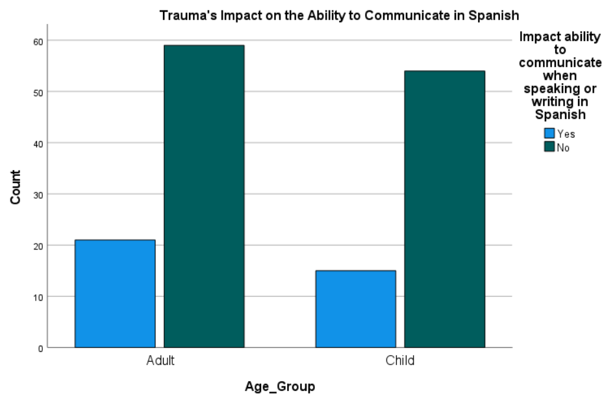
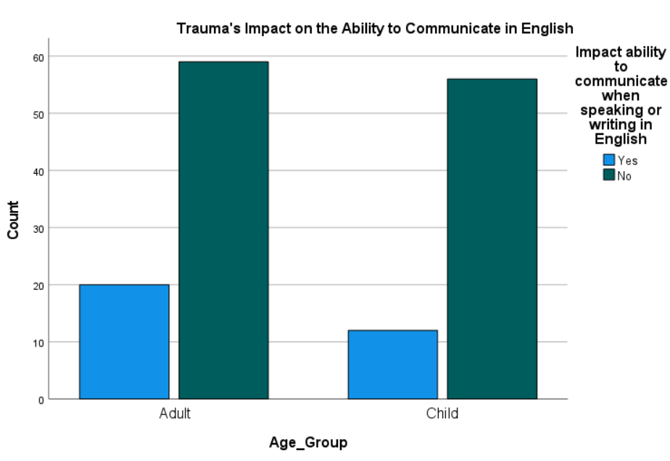
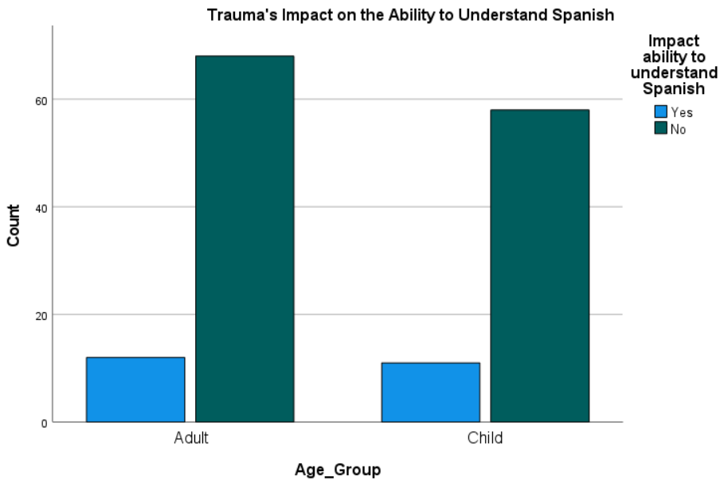
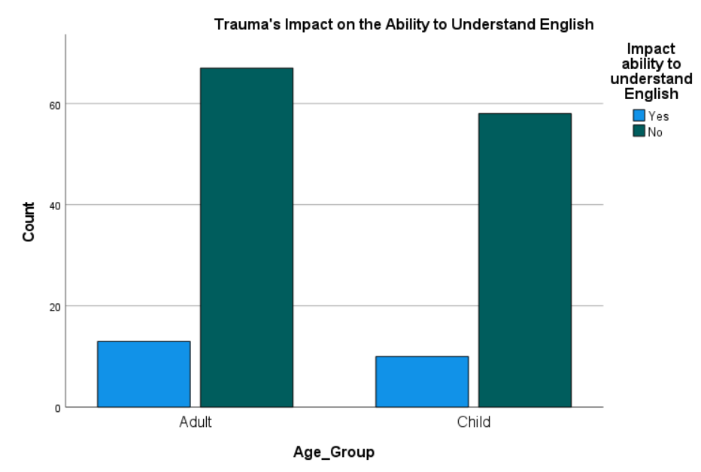
The Subjective Impact of Post Traumatic Stress on Cognitive-Communication in Spanish-Speaking Bilingual Children & Adults
Jennifer Rae Myers, PhD, MS, CCC-SLP^{1,2}, Deja Bulluck, BS^{2,3}, Brittney C. Ford, BA^{2,3}, Bejani Turley BA, SLP-A^{2,3}, Sulare Telford-Rose, PhD, CCC-SLP^{2,3}
¹The Raymond Banks ‘A Way With Words’ Foundation; ² Culturally S.M.A.R.T. Program; ³ The University of the District of Columbia
LEARNING OBJECTIVES
DATA ANALYSIS & RESULTS
DISCUSSION
At the culmination of the poster presentation, the attendee will be able to:
Identify specific language processes reported to be impacted by trauma
Discuss the clinical implications of trauma on cognitive-communication skills among bilingual individuals
A series of chi-square tests of association were conducted to determine if age group (children, adults) is associated with whether or not trauma impacted their language skills. For the analysis, the following questions from the survey were used:
“Do you feel that the traumatic experience impacted your (your child’s) ability to communicate when speaking or writing in Spanish( English)?”
“Do you feel that the traumatic experience impacted your (your child’s) ability to understand Spanish (English)?”
Data from a total of 82 adults (mean age 33.83, SD 7.06) and 71 children (mean age 11.55, SD 2.49) was included in the final analysis. Results from the chi-square tests revealed no significant association between age group and the impact of trauma on language processes:
Ability to speak or write in Spanish, , X² (1, N = 149) = .411, p = .521
Ability to speak or write in English , X² (1, N = 147) = 1.262, p = .261
Ability to understand Spanish, X² (1, N = 149) = .025, p = .874
Ability to understand English, X² (1, N = 148) = .067 p = .796
Our findings show no significant association between age group and the subjective impact of post traumatic stress on language processes. It may be the case that impact of trauma may affect both children and adults but manifests in different ways.
While the results were not significant, this novel investigation highlights the general subjective impact of trauma on language processes regardless of age group and provides clinicians with important considerations for standard-of-care practices. Additional research is underway to assess the objective impact of trauma on language and other cognitive-communication skills to determine to what extent trauma effects language ability.
INTRODUCTION
Studies have shown that trauma can negatively
affect an individual’s cognitive function, including
cognitive processes necessary for language
development and overall communication.¹⁻³
However, the effect of trauma on cognitive
communication has been vastly understudied
regarding bilingual populations.
Therefore, this survey study aims to address a
critical gap in the literature by investigating if
trauma impacts language processes more in
Spanish-speaking bilingual children or adults.
REFERENCES
Kaplan, I., Stolk, Y., Valibhoy, M., Tucker, A., & Baker, J. (2016). Cognitive assessment of refugee children: Effects of trauma and new language acquisition. Transcultural psychiatry, 53(1), 81-109.
Söndergaard, H. P., & Theorell, T. (2004). Language acquisition in relation to cumulative posttraumatic stress disorder symptom load over time in a sample of resettled refugees. Psychotherapy and psychosomatics, 73(5), 320-323.
Kavanaugh, B., & Holler, K. (2014). Executive, emotional, and language functioning following childhood maltreatment and the influence of pediatric PTSD. Journal of Child & Adolescent Trauma, 7(2), 121-130.
METHOD
As part of a larger ongoing study, Spanish-speaking bilinguals (ages 21-60) who endorsed experiencing trauma in the past 5 years completed a survey with questions related to their background, language skills, cognitive communication skills, and history of trauma.
Interested respondents with a Spanish-speaking bilingual child (ages 7-16) completed an additional questionnaire on their behalf.
Each survey took approximately 20 minutes to complete. Respondents provided informed consent and were compensated $15 for each completed survey with approval from the University of the District of Columbia’s IRB.
ACKNOWLEDGEMENT
This project was supported by a multicultural grant from the American Speech Language and Hearing Association to Drs. Jennifer Rae Myers and Sulare Telford-Rose. The authors thank the participants for their time and effort in completing the survey.

